Slide 1
OSG Executive Director Report OSG Council Meeting May 19th 2011 Ruth Pordes

Slide 2
Status of Proposals

Slide 3
Recap of Proposal to NSF
Proposed full scope of program of work deemed necessary to sustain and extend OSG FY12-FY16
Full scope is 32.3 FTEs ($~8M). Requested 40%.
One request received to clarify this.
No news since then.
…to transform the science and research computing landscape on our campuses through wide adoption of a new generation of DHTC technologies that support access to “any data, anytime, anywhere”, to an expanded set of job and data services via a single identity, and enable the transformation of our core stakeholders computing capabilities from petascale to exascale.

Slide 4
SciDAC-3 ASCR Proposal
Institute for Distributed High Throughput Computing (InDHTC) submitted to SciDAC-3 ASCR, May 3rd.
Institute Director – Miron
Associate Director – Lothar
… enhance and expand the impact of DHTC on DOE science through close interdisciplinary collaborations with the broader community that will research and formulate novel frameworks, develop advanced technologies, and build state-of-the-art software tools. This effort will build upon the foundation established over the past 5 years by the Open Science Grid1 (OSG),

Slide 5
InDHTC
Areas of Work: Data, Security, Systems, Workflow and Tools
Each has its own program of work.
All the members of the Institute
Engage Science Communities.
Create the Intellectual Foundation for DHTC.
Survey, Evaluate, and Recommend Technology.
Create New Technologies and Techniques.
Improve Error Propagation and Failure Handling.
10 FTEs of which ~5 FTEs are part of the previous Full Scope proposal (32.3FTEs):

Slide 6
Technical, Computer Science Areas
Data
Doug Thain, Notre Dame
Security
Von Welch, Indiana University
Also effort from Fermilab, UWisconsin,
Workflow
Ewa Deelman, ISI
Systems
Brian Bockelman, UNL
Also effort from Fermilab, BNL
Software Tools
Brooklin Gore, Mortridge Institute of Research, Wisconsin*
*http://discovery.wisc.edu/home/discovery/about-us/about-us.cmsx

Slide 7
DATA
Interpositioning Techniques. In order to take advantage of any but the most trivial I/O services, HTC applications must be coupled to the I/O system at runtime by interposing on I/O operations.
Data Access Continuum: staging might be employed for known inputs,.. remote I/O ..for unexpected access.
Resource Allocation. …models of interaction whereby clients can request specific levels of service and servers have the ability to accept, decline, or delay as needed. This requires first defining coherent policies for allocating resources, and then mechanisms that can measure and enforce bandwidth limits, concurrency limits, and storage capacity.
Dynamic Deployment. … a growing number of DHTC use cases, the end user or a supporting virtual organization is responsible for deploying support services.
Matchmaking for Data Access. New models and mechanisms are needed for specifying system capacity, reporting it to matchmakers, and exploiting the information at runtime.

Slide 8
Security
A Trust Framework for secure software development and integration … for discerning, expressing and optimizing trust models across diverse and autonomous organizations and resources,
Framework for Risk Assessment and Mitigation for Distributed Science… Extending conventional, organization-oriented risk management processes across a DHTC environment to maximize trust and dependability.
Workflow
Automating the workflow lifecycle. by including automatic resource provisioning, would potentially greatly simplify the work of domain scientists that use workflow technologies and would improve times to solution.
Failure Management. identify the types of expected failures and to explore options for how they can be identified, communicated and dealt with at the workflow level.
Debugging and monitoring. presenting monitoring and debugging information to users who interact with the system at the level of abstraction provided by the workflow system.
Managing workflow ensembles.

Slide 9
Systems
Focuses on system architectures that capture the structure and intra-relationships of a DHTC environment
~Technology Investigations: Incorporate virtualized resources into a DHTC architecture; Evolving computer architectures; Integrate advanced networking into DHTC architectures.
Tools
“’a Jiffy Lube‘ for DHTC tools. When a car leaves Jiffy Lube, you are sure that it has been tuned, lubed and optimized for efficient, trouble-free operation on the road.
facilitate tuning and optimizing tools for efficient, trouble-free operation in DHTC facilities
facilitate the optimization of tools for the broader DHTC community including university campus infrastructures by expanding and tightening the bridge between tool developers and DHTC facility operators.

Slide 10
inDHTC Relationships
*
*Institute for Software Technology for Emerging Petascale Systems (STEPS) delivers tools such as the MRNet multicast/reduction network for more robust service management.

Slide 11
Organization
Institute Director has overall responsibility for setting directions and managing the research agenda, coordinating the program between Areas and participating institutions and for ensuring that the objectives of the Institute are met.
Associate Director, who serves as executive officer and facilitates the liaison to collaborators
The unit of management and accountability will be a Project, …typically be on the scale of something achievable in weeks to months, such as writing a report, or evaluating a technology or diagnosing a collaborator’s problem. Some Projects will draw effort from only one Area, others will draw from several Areas, and may include external collaborators coming from the domain science communities or from other SciDAC Institutes.
All activities of the Institute will be accounted to a Project, allowing the leadership team to maintain a clear understanding of all InDHTC efforts.

Slide 12
Needed Commitments to OSG
1.0 FTE Security Extensions -> InDHTC Security.
1.5 FTE new software in VDT -> InDHTC Tools.
1.5. FTE Technology Investigation -> InDHTC Systems.
0.2 FTE Technical Director -> InDHTC Institute Director.
0.5 FTE “Contribution” from InDHTC -> OSG cross-cutting staff.

Slide 13
InDHTC External Advisory Group
The External Advisory Committee consists of up to five representatives of the communities the InDHTC is currently benefiting and can potentially benefit in the near future (e.g., Earth Systems Grid, Genome Institute, OSG, a representative of another SciDAC Institute).
The DOE program officer responsible for the SciDAC-3 program and the InDHTC leadership are ex-officio members of this committee.
The EAC provides strategic advice to the InDHTC through the leadership on the evolution of the institute to increase its impact and applicability to the DOE science community and expand the user communities it serves. Members of the committee may attend the quarterly IB meetings. Twice a year the committee meets to hear from collaborators and beneficiaries of the work and provides the InDHTC leadership a report of its recommendations and findings.

Slide 14
FY12 as we know it today

Slide 15
Note on Current Plans for FY12
Project funds will “fall off a cliff” sometime in FY12 if no additional funds forthcoming. When depends on our staff planning for FY12.
Finance Board Executive Team discussion/decision to move to FY12-FY16 restructure “as far as possible”.
Need to move forward on Program Vision and Goals:
Needed new services
Apply needed technologies.
Support existing and new communities on the campus and in research.

Slide 16
Need continuing Contact and Communication with Program Managers
DOE ASCR – Rich Carlson
DOE HEP – Alan Stone transitioning to Lali Chatterjee.
DOE NP – Ted Barnes?
NSF MPS – Marv Goldberg, LIGO, Ed Seidel?
NSF OCI – Kevin Thompson
Fellow travellers?
Moise Pripstein, Glen Crawford, Barry Schneider, Ed Seidel and..
ET – every few months phone meeting with DOE. Next one June 2nd.
ATLAS/CMS – biweekly meetings with DOE/NSF, mainly covers maintenance and operations end-to-end
Miron has regular discussions with Kevin Thompson.

Slide 17
Staffing Plans continue to change
Implications for institutions not part of the OSG’ proposal:
LBNL continued funding on existing ASCR funds – expect some to last til ?mid-March? for Bestman support
Caltech continued funding on roll-over FY11 funds – expect to last til ?mid-Nov? (plan move of Robert Engel to Florida in Fall 2011)
Ramp up proposed for some institutions not possible e.g. UIUC backup for operations.
Chander starting to talk individually to organizational Pis and will give area coordinators guidance for FY12 Work Planning in the next month or so.
If we hear nothing from the funding agencies by end of August we will likely scale back staff so can fall of the cliff “later” e.g. might try to move It from ~Mar to ~July or Aug 2012??

Slide 18
Docked Projects.. How we got there..

Slide 19
DOCKED Projects
contribute to and receive contributions from
the OSG Project through annually agreed upon deliverables and agreements,
through one or more bi-directional connections to OSG Technical, Cross-Cutting areas and the Executive Team
In order to provide most effective value to the OSG Consortium.
DOCKED projects
often have broader scope than the OSG itself and have separate reporting, oversight and external advisory groups.
Notes:
19

Slide 20
OSG Council
Program Oversight
Scientific – External
Advisory Group
C
OSG Executive Team
?
InDHTC
?Campus Shared CI?
?Operating the National Production Grid?

Slide 21
Where we are today
Notes:
21

Slide 22
Program Oversight
OSG 2011-2016
Scientific Advisory Group
OSG Consortium
Contributors
Communities & VOs
Universities & Laboratories
Service & Software Providers
Scientists, Researchers,
Educators, Students
Members
Communities
Satellites
Partners
OSG Council
Council Chair
Executive Team
Executive Director
Technical Director
Application Coordinators
Production Coordinator
Project Manager
Security
Software
Technology
User Support
Operations
Resources Manager
Council Co-Chairs (Ex-officio)
OSG PI and Co-PIs
Projects
Project Managers
Satellite Managers
Technologies & Software
Communities
Line Reporting
Contributory
Executive Board
Advisory

Slide 23
Where we are today
were
Notes:
23

Slide 24
Program Oversight
OSG 2011-2016
Scientific Advisory Group
5 Program Offices across DOE and NSF contributing to a Single Project
OSG Consortium
Contributors
Communities & VOs
Universities & Laboratories
Service & Software Providers
Scientists, Researchers,
Educators, Students
Members
Communities
Satellites
Partners
OSG Council
Council Chair
Executive Team
Executive Director
Technical Director
Application Coordinators
Production Coordinator
Project Manager
Security
Software
Technology
User Support
Operations
Resources Manager
Council Co-Chairs (Ex-officio)
OSG PI and Co-PIs
2006-2011
OSG Project
Projects
Project Managers
Satellite Managers
Technologies & Software
Communities
Line Reporting
Contributory
Executive Board
Advisory

Slide 25
Satellite Projects
2010
Open Science Grid
Services and
Infrastructure
Support for End-to-End Distributed Research Community systems.
Contributions
Executive
Board
OSG does not own processing, storage, networking and does not develop software.
Science
Community
$
DOE
Software
Provider
OSG
Consortium
& Council
OSG
Project
$
NSF
Resource
Provider
..
..
Satellite -
Partner
Project
Satellite
Project

Slide 26
Satellites
Deliverables contribute to OSG – not part of committed /necessary/ program of work.
Contributions have proven valuable (expect this to continue..)
CI-Team – Engagement of new users; Development of processes of engagement; Ensures” opportunistic”, “single user” aspects of OSG are available and effective.
HTPC – Extend technologies and processes on OSG to support multi-core and small-way (# cores on a CPU) parallel jobs. CMS/ATLAS need this as well as new communities such as Computational Chemistry.
CorralWMS – Resource provisioning; Support for job ensembles across OSG and TG sites. Needed by several new communities being engaged by OSG: NEES, DES, LSST.
ANI, 100 Gigabit Testbed – Test OSG stakeholder end-to-end systems on advanced networks and participate with the DOE Magellan Cloud Testbed.
Extenci – Technical and User support collaboration between OSG and TG setting the scene for OSG as an XD Service Provider from summer 2011.
OSG-TG Student Summer Programs – Enable students to learn the fundamentals of distributed computing in HTC and HPC environments.
On the ground enablers of better, more forward looking OSG infrastructure, technologies, services; value to and support for a broader set of communities.

Slide 27
Where we are (organizationally) tomorrow
Notes:
27

Slide 28
OSG’ 2006-2011
32.3 FTEs (~$8M) of NECESSARY program of Work
Executive Director: Ruth Pordes
Technical Director: Miron Livny
Associate Technical Director: Lothar Bauerdick - TBE
Application Coordinators: Michael Ernst, Frank Wüerthwein
Production Coordinator: Dan Fraser
Project Manager: Chander Sehgal
Executive Team
Resources Manager: Frank Wüerthwein
Operations: Rob Quick
Production: Dan Fraser
Cross Cutting Activities:
Assessment: Rob Gardner
Communications: Miriam Boone
Documentation: Robert Engel
Education: Tim Cartwright
International Outreach: Jose Caballero
Campus: Dan Fraser
Security: Mine Altunay
Software: Alain Roy
Technology: Brian Bockelman
User Support: Chander Sehgal
Notes:
28

Slide 29
It has become clear..
Each Program Office across
DOE and NSF likely to contribute to a different project on a different timeline
OCI
ASCR
DOE HEP
NSF MPS
Notes:
29

Slide 30
DOE HEP (NP) funding
finished Mar 2011..
OCI
ASCR
DOE HEP, NP
NSF MPS
1 year extension to
Mar 2012.
Slides from “Challenges and Evolution of the LHC Production Grid”, Ian Fisk, talk at EGI User Forum
Notes:
30

Slide 31
Rest of OSG project finishes in Sept 2011
OCI
ASCR
DOE HEP
NSF MPS
So In March we submitted 40% Budget to NSF for 5 year program of work.
1 year extension Mar 2011- Mar 2012.
Notes:
31

Slide 32
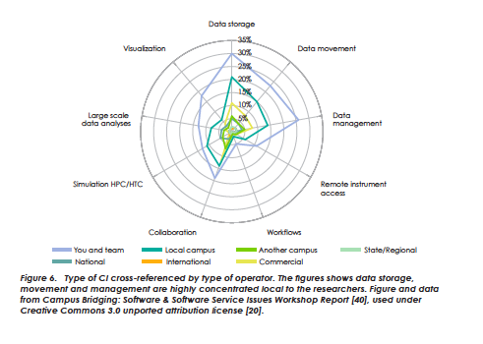
Some programs require scope and goals that are broader than what is ESSENTIAL for the OSG
Each Program Office across
DOE and NSF “expect” to contribute to a Different Project
OCI
Campus Infrastructure ?
Software Institute?
ASCR
SciDAC-3 Institutes
DOE HEP
SciDAC-3
Science Application Project?
LHC operations?
1 year extension Mar 2011- Mar 2012.
NSF MPS
OSG’
submitted 40% Budget to NSF 2012 thru 2016.
from Campus Bridging Taskforce report
Notes:
32

Slide 33
We submitted a proposal to ASCR where 50% of the FTEs are contributing ESSENTIAL activities to OSG program
Each Program Office across
DOE and NSF “expect” to contribute to a Different Project
OCI
Campus Infrastructure ?
Software Institute?
ASCR
SciDAC-3 Institutes
SciDAC-3: InDHTC for 10FTEs of which 5 FTEs overlap/are moved from full OSG program.
DOE HEP/NP
NSF MPS
OSG’
Notes:
33

Slide 34
Proposals we expect to submit yet this year..
Each Program Office across
DOE and NSF “expect” to contribute to a Different Project
OCI
Campus Infrastructure ?
Software Institute?
Waiting for the right solicitation. Some small possibility OCI may contribute to NSF proposal already submitted.
Currently working with 2 possible satellites for SSI/SSE in July (see later)
ASCR
SciDAC-3 Institutes
InDHTC 5 FTEs overlap/are moved from full OSG program.
DOE HEP
SciDAC-3
Science Application Project?
LHC operations?
1 year extension Mar 2011- Mar 2012.
NSF MPS
OSG’
Expect a SciDAC-3 Science Application Program solicitation summer 2011.
submitted 40% Budget to NSF 2012 thru 2016.
Notes:
34

Slide 35
the question :
How to preserve the coherence, commonality, collaboration and expertise, engagement and energy of the successes and vision of the OSG Consortium and Core Project with this Eco-System?
Each Program Office across
DOE and NSF “expect” to contribute to a Different Project
OCI
Campus Infrastructure ?
Software Institute?
Waiting for the right solicitation, with some possibility may contribute to NSF proposal already submitted..
ASCR
SciDAC-3 Institute
5 FTEs overlap/are moved from OSG. InDHTC delivers ESSENTIAL activities to OSG.
DOE HEP
SciDAC-3
Science Application Project?
LHC operations?
Expect a SciDAC-3 Science Application Program solicitation summer 2011.
1 year extension Mar 2011- Mar 2012.
NSF MPS
OSG’
submitted 40% Budget to NSF 2012 thru 2016.
Notes:
35

Slide 36
DOCKED Projects
contribute to and receive contributions from
the OSG Project through annually agreed upon deliverables and agreements,
through one or more bi-directional connections to OSG Technical, Cross-Cutting areas and the Executive Team
In order to provide most effective value to the OSG Consortium.
DOCKED projects
often have broader scope than the OSG itself and have separate reporting, oversight and external advisory groups.
Notes:
36

Slide 37
First example: OSG and InDHTC
OSG Project
InDHTC
Other Facilities, User Communities, SciDAC Institutes
OSG Consortium & Council
Executive Team
Leadership
Science Advisory Group
External Advisory
Committee
Production
Data
Program Oversight
Security
Security
Program Oversight
Software
Tools
Technology
Systems
User Support
Workflow
Cross Cutting
Contribution
Each project
Shares some leadership with the Executive Team/Management
Contributes to the Cross Cutting activities.
Ensures bi-directional communication and coordination of the annual program of work and deliverables.
…
Notes:
37

Slide 38
OSG Council
Program Oversight
Scientific – External
Advisory Group
C
OSG Executive Team
?
InDHTC
?Campus Shared CI?
?Operating the National Production Grid?

Slide 39
several other opportunities ongoing/on the horizon..
Notes:
39

Slide 40
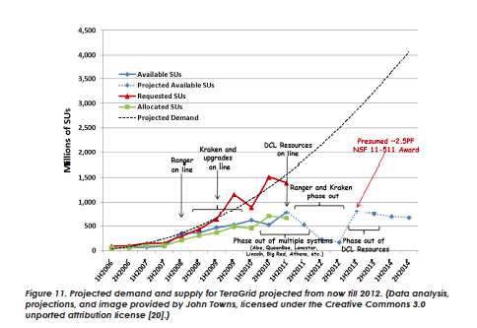
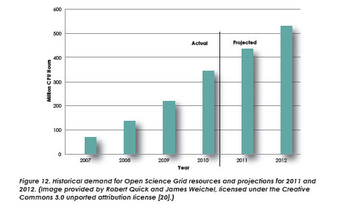
Contributors
Members
Communities
Satellites
Partners
OSG
OSG is an
XD –XSEDE
Service Provider
Seat on the SP Forum.
Contributions from Campus Champions &
Advanced User Support.
Sharing of Security Staff.
Possibility to participate in the Allocation Process
Common/collaborative support for such
communities as DES, LSST, NEES.
from Campus Bridging Taskforce report

Slide 41
OSG
Campus
Infrastructures
OSG is an
XD –XSEDE
Service Provider
Campus Grids initiative bringing in new partners who benefit from our skills, technologies, whose scope and focus is “local” and likely to remain so for a while, and whose users are supported but the local teams.
NSF task force reports stress the importance of Campuses.
e.g. Virginia Tech.

Slide 42
NEES /NEESHub
Starting to show value to individual users of running simulations (OpenSees) on OSG.
Process of acceptance must be careful and slow.
OSG
Campus
Infrastructures
OSG is an
XD –XSEDE
Service Provider

Slide 43
European Grid
Initiative (EGI)
NEES &
NEESHub
eNMR structural biology VO working through SBGrid to enable bi-directional partnering across 2 infrastructures.
OSG
Campus
Infrastructures
OSG is an
XD –XSEDE
Service Provider

Slide 44
The Americas:
GridUNESP
Colombia Grid
International Project Possibilities with WLCG? LHC? Co-funded by EU and US?
European Grid
Initiative (EGI)
NEES &
NEESHub
Action Item: Technical Director meeting with IRODS in July
OSG
Extension of Data Transport collaborating with Globus Online
DOE/NSF aim to make cross agency MAGIC more useful?
Campus
Infrastructures
OSG is an
XD –XSEDE
Service Provider
Partner with more SciDAC-3 Institutes through InDHTC?
Condor receives
REDHAT award

Slide 45
Program Oversight
OSG 2011-2016
Scientific Advisory Group
OSG Consortium
Contributors
Communities & VOs
Universities & Laboratories
Service & Software Providers
Scientists, Researchers,
Educators, Students
Members
Communities
Satellites
Partners
OSG Council
Council Chair
Executive Team
Executive Director
Technical Director
Application Coordinators
Production Coordinator
Project Manager
Security
Software
Technology
User Support
Operations
Resources Manager
Council Co-Chairs (Ex-officio)
OSG PI and Co-PIs
Projects
Project Managers
Satellite Managers
Time to rework our model based on the expanded eco-system ??
Technologies & Software
Communities
Line Reporting
Contributory
Executive Board
Advisory

Slide 46
e.g. Assessment Activities

Slide 47
Follow up work by Rob Garner and Tom Hacker presented to “volunteers” this morning. From the March Council minutes: “T. Hacker: The problem is if you start collecting information, need to roll it up into strategic plans. RG and TH talk later, leverage what NEES has done. More discussion about how this works for NEES and striking the right balance, and what we call the cost of running OSG. In Exec Team, we tend to discuss things before but not after they happen. We define deliverables for phases, there’s a specific time line, but no formal mechanism to look at the dashboard.” NEES system: https://twiki.grid.iu.edu/twiki/pub/Management/WebHome/NEES_Performance_Management_System-_Tom_2011-05-19_final.pptx OSG thoughts: https://twiki.grid.iu.edu/twiki/pub/Management/WebHome/assessment-osg-05.19.2011.key.pdf
Next Steps towards Assessment

Slide 48
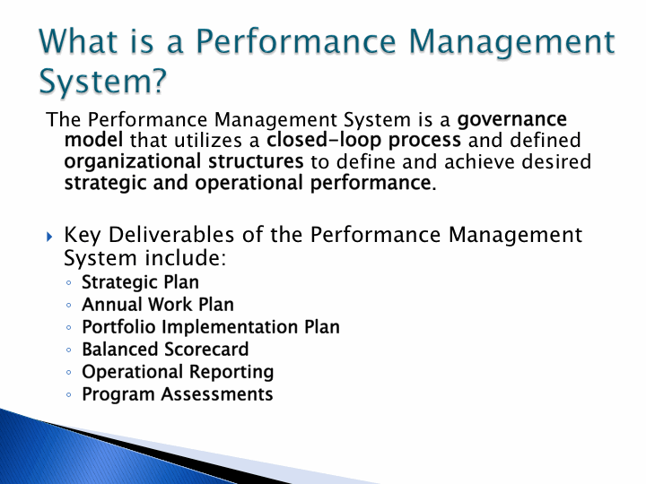

Slide 49
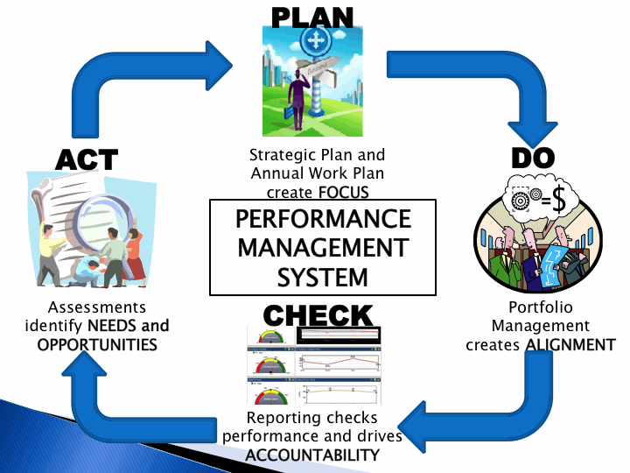
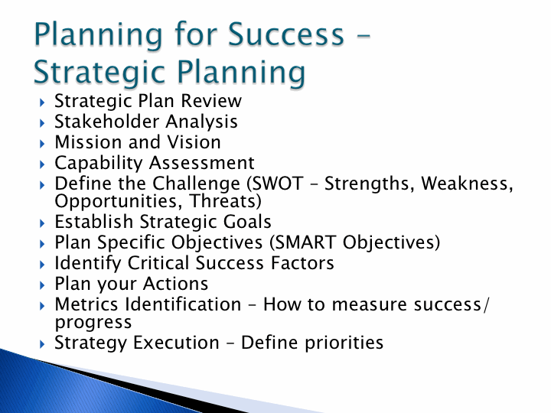
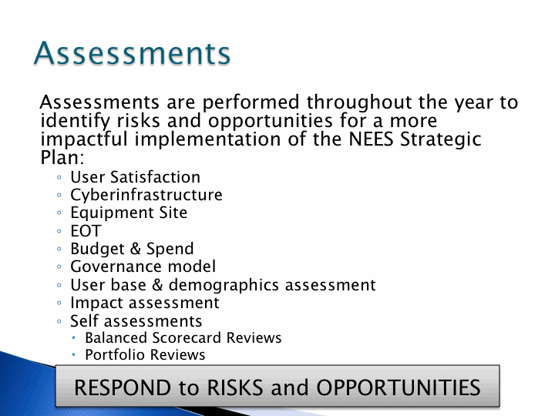
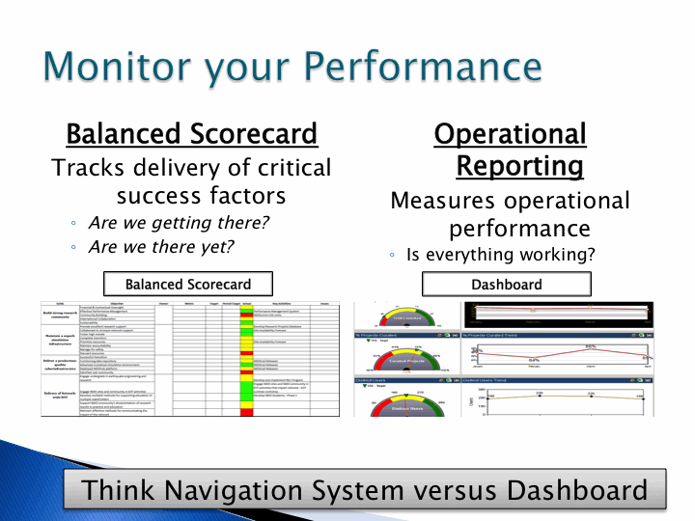

Slide 50
from Rob – planning for Assessment

Slide 51
How the NEES ideas Map to OSG

Slide 52
Assessment Project Process

Slide 53
Executive Director Accepts the Input!
I will work with Rob and the Executive Team to have a Strategic Plan discussions, input (Council, stakeholders, users, staff… ), draft and review, by June 30th.

Slide 54
OSG Project Associate Executive Director

Slide 55
The OSG Associate Executive Director ..
acts as the liaison to the associated projects, such as Institutes, that make needed contributions to the scope of work of the OSG project.
is a member of the Executive Team.
ensures effective communication of the (technical, schedule, process) requirements of OSG and its stakeholders to the associated projects,
agreement and delivery of the contributions from the associated projects, and
ensure an effective matching of the ongoing program of work to the scientific needs of the stakeholders from the OSG.

Slide 56
Associate Executive Director relationship to OSG Project Manager
Associate Executive Director communicates bi-directionally between the OSG Core Project and the Associated Projects.
The OSG Project Manager
defines and tracks the deliverables, milestones, costs and resources of the OSG program of work.
defines and tracks the annual program of work and the day-to-day deliverables and schedule of the program.
tracks and recommends the distribution of costs and effort.
coordinates reporting of the Projects as they impact the OSG.

Slide 57
I ask the Council’s endorsement of the appointment of Lothar Bauerdick as OSG Project Associate Executive Director.
Clearly Lothar has many other responsibilities. He will be committed to 0.2 FTE for InDHTC and we expect part of this time overlapped with the InDHTC work as part of the core OSG management team.

